Slide 1
Spokane Reference Site Layout
Urbanova | Smart Cities
2017-08-02

Slide 2
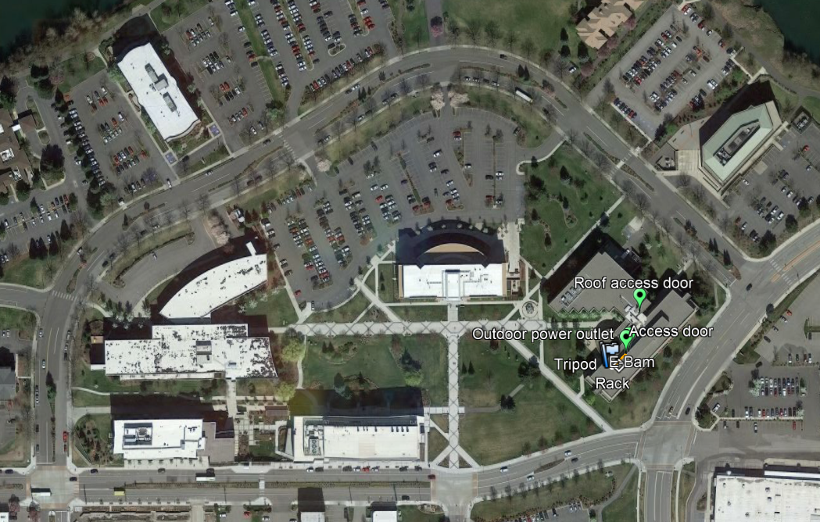
Orientation view: WSU Spokane campus

Slide 3
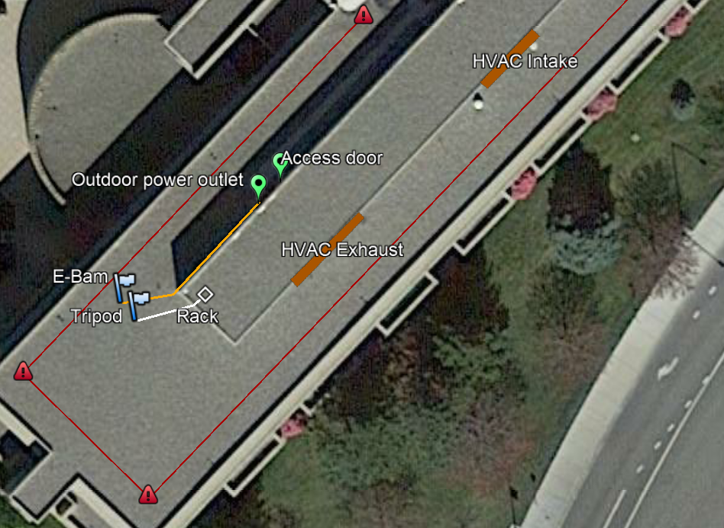
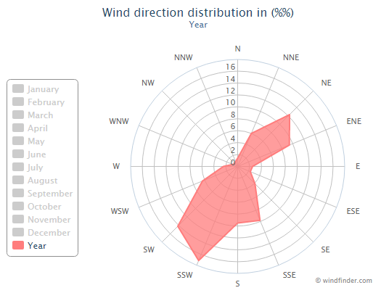

Slide 4
Proposed Location of Access Holes
SW Wall
(not to scale…)
Top View
Of Penthouse
1.5-2” Ø or 2 @ 1”
Tripod inlet here
min 12”
6”
Proposed Location of Holes
Possible locations for holes

